Slide 1
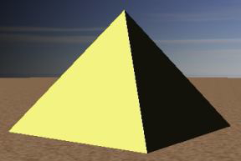
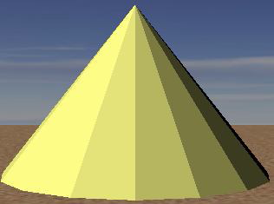
Introduction to 3D Graphics
Using OpenGL 3D

Slide 2
Classical Graphics Pipeline
Mesh objects with 3D polygons (triangles or quads usually)
Apply material properties to each object
Texture map polygons as needed
Light scene
Place camera
Enjoy the view

Slide 3
Why OpenGL for 3D?
Widely used in industry and academia for interactive or real-time 3D graphics
Fixed-function API (OpenGL 1.x) assists rapid prototyping of simple 3D scenes with “classical” lighting effects
Experiment with simple ideas quickly

Slide 4
3D Polygons (1/2)
Material specification
Describes the light reflecting properties of the polygon
Color, shininess, reflectiveness, etc ...
float color[] = { 1.0, 1.0, 0.3, 1.0 }; // Pale yellow
glMaterialfv(GL_FRONT, // Color of front (visible) faces
GL_DIFFUSE, // “Base” color (more later)
color); // Pass in the R/G/B/A color values

Slide 5
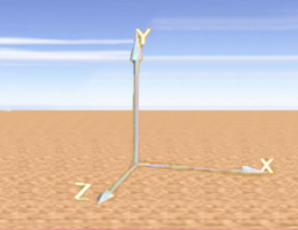
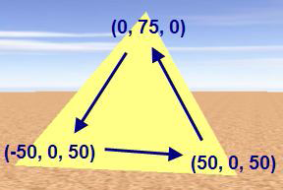
3D Polygons (2/2)
OpenGL defaults to a right-handed coordinate system
3D polygons are defined like 2D polygons: glBegin(GL_TRIANGLES); glVertex3f(0, 75, 0); glVertex3f(-50, 0, 50); glVertex3f(50, 0, 50); glEnd();
This defines one triangle
Coordinate values are arbitrary - can set virtual camera up to capture any size scene, so use convenient values
Remember counter-clockwise winding order!

Slide 6
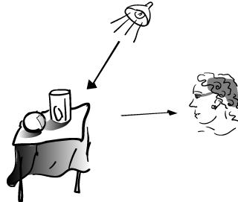
Complexities of Light Reflection from Surfaces
Need to know intensity and direction of all light that strikes a point on object's surface, whether directly from light source or after many bounces (i.e., global illumination)
How an object's surface appears to us as it reflects, absorbs and diffracts light (material properties)
Location of eye relative to light source
Distribution of intensity per wavelength of incident light
Human visual system (HVS) and its differential response to light stimuli
Lights may have geometry themselves
Lighting/illumination models address these complexities (except for HVS)

Slide 7
An Imperfect World
Classic lighting models (also called illumination or reflection models, not to be confused with shading models discussed later) developed at the dawn of raster graphics in early 70s.
Epicenter at University of Utah where Ivan Sutherland worked with David Evans
Spawned the Evans & Sutherland flight simulator (with graphics) business
Other pioneers:
Gouraud (shading model – filling in interior pixels from colors at vertices of a triangle)
Phong (lighting and shading models)
Newell (the Utah teapot (SIGGRAPH icon), meshing algorithms)
Clark (geometry engine, Silicon Graphics, Netscape)
Warnock (Hidden Surface Elimination, Adobe)
Catmull (splines, Pixar), etc...

Slide 8
An Imperfect World
Back then:
CPUs > 4 orders of magnitude less powerful; no GPU to speak off: plot pixels
memory limited (measured in KB!)
Even on today's machines, a physically accurate light simulation requires computational power beyond the capabilities of supercomputers!

Slide 9
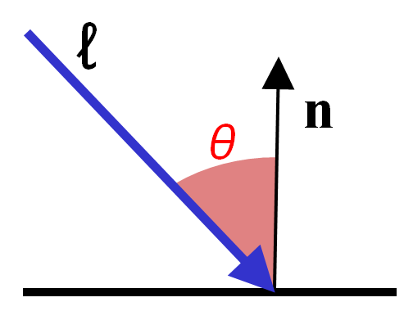
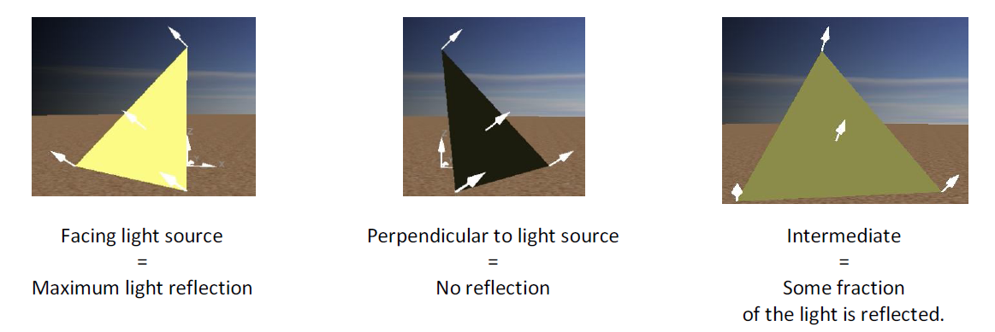
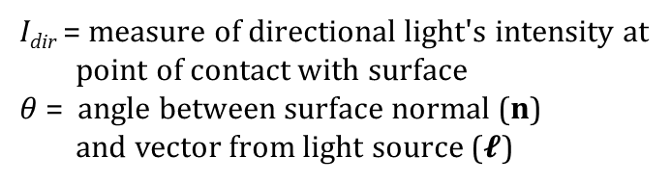
Lighting (Illumination) Models (1/2)
Color of point on surface dependent on scene lighting and surface material
First approximation: model diffuse reflection from a matte surface (light reflected equally in all directions, viewer-independent) based only on angle of surface normal to light source
Modeling light "drop-off“ with angle to light
Lambert's diffuse-reflection cosine law
for reflected light intensity I
I_{dir} = measure of directional light's intensity at
point of contact with surface
$θ$ = angle between surface normal (n)
and vector from light source (ℓ)
Facing light source:
Maximum reflection
to light source:
No reflection
note: I_{dir} and all the other quantities in the lighting model are fractions between 0 and 1.
These units are also completely arbitrary and not physically based!
In between: Some fraction of light reflected

Slide 10
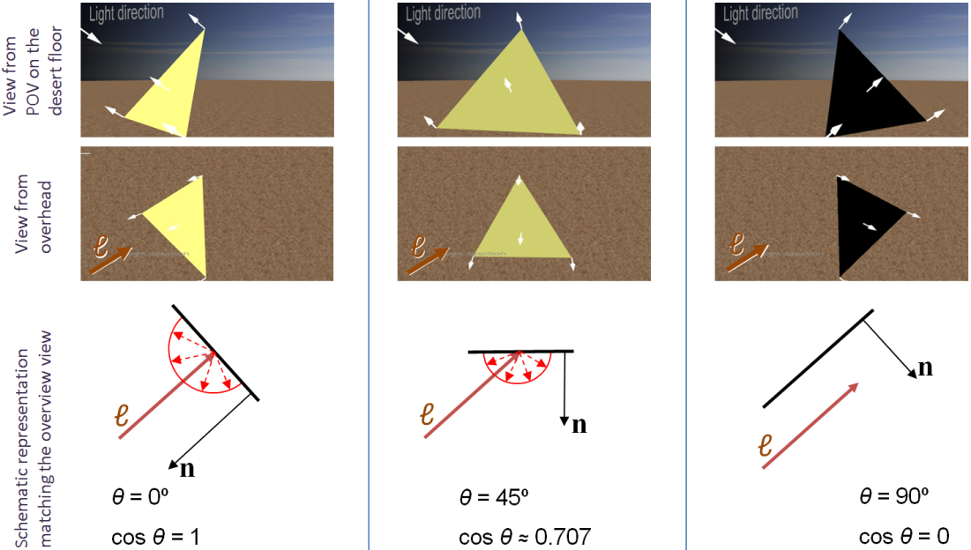
Lighting (Illumination) Models (2/2)
Lambert light attenuation based on surface's angle to light source
Visualization of Lambert's law in 2D
Note: we haven't accounted for "material properties", i.e., the fractions of the incident light energy absorbed vs. reflected at each wavelength. Think of this as the “reflection efficiency coefficient”.

Slide 11
Shading Rule (1/6)
Goal: finding color at each pixel, preferably w/o having to evaluate a full lighting model at each pixel
First approach: Lambert's cosine law (flat/constant shading for whole facet)
faceted appearance, perfect for this rectangular pyramid.
What if we want to approximate a rounded object?
Lambert-shaded, faceted; appearance is no longer ideal
www.sklardevelopment.com/graftext/wpf/3d

Slide 12
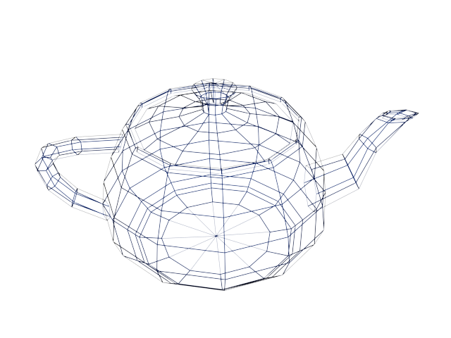
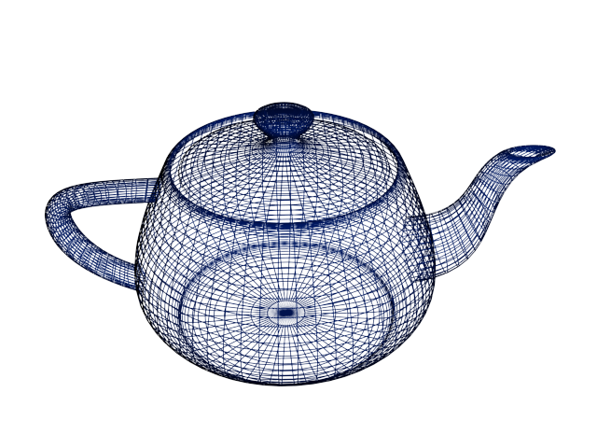
Shading Rule (2/6)
First solution: increase the number of polygons
Better shape approximation, more expensive to render
Ultimately, still faceted when rendered (higher poly count = less faceted)
Adaptive meshing is an improvement - more polygons in areas of high curvature
“Utah Teapot” by Martin Newell

Slide 13
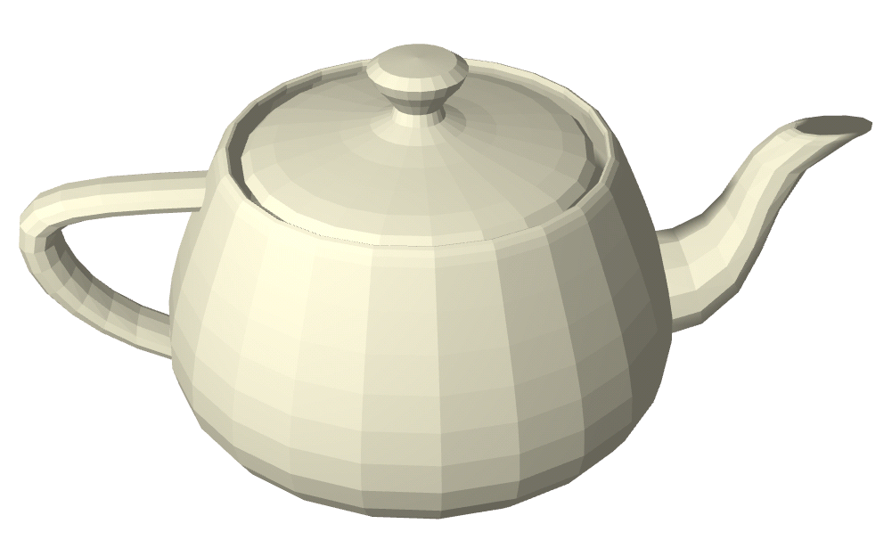
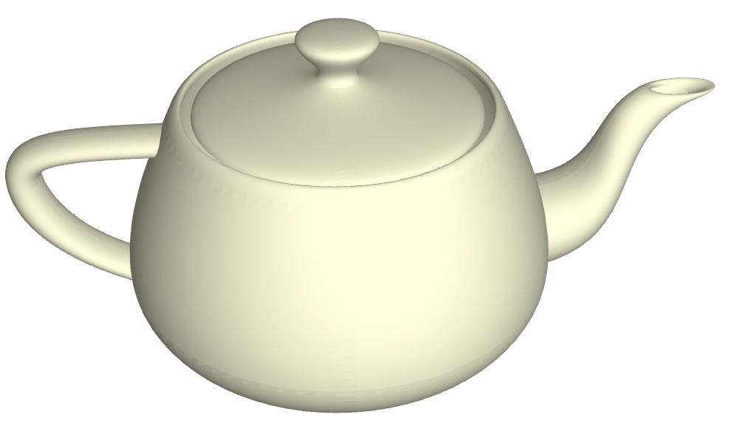
Shading Rule (3/6)
Get this:
Want this:
faceted shading
smooth shading

Slide 14
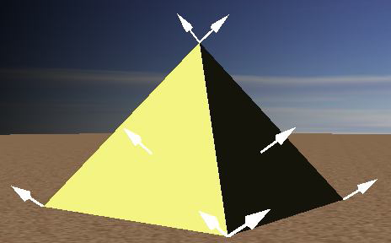
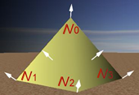
Shading Rule (4/6)
Gouraud smooth shading
compute lighting equation at each vertex of mesh
linearly interpolate vertex color values to get colors at all points
weighted averaging: the closer the point is to a vertex, the more it is influenced by that vertex
how do we determine vertex colors? Need a normal…
the "artifice" of vertex normals; mathematically undefined since a vertex is a discontinuity
we hack around this by averaging
The normal at a vertex is the same as the plane normal. Therefore, each vertex has as many normals as the number of planes it helps define.
Faceted
Only one vertex normal per vertex; average of face normals of faces the vertex is part of
Smooth

Slide 15
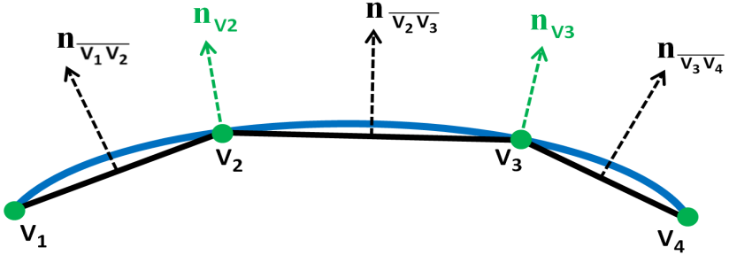
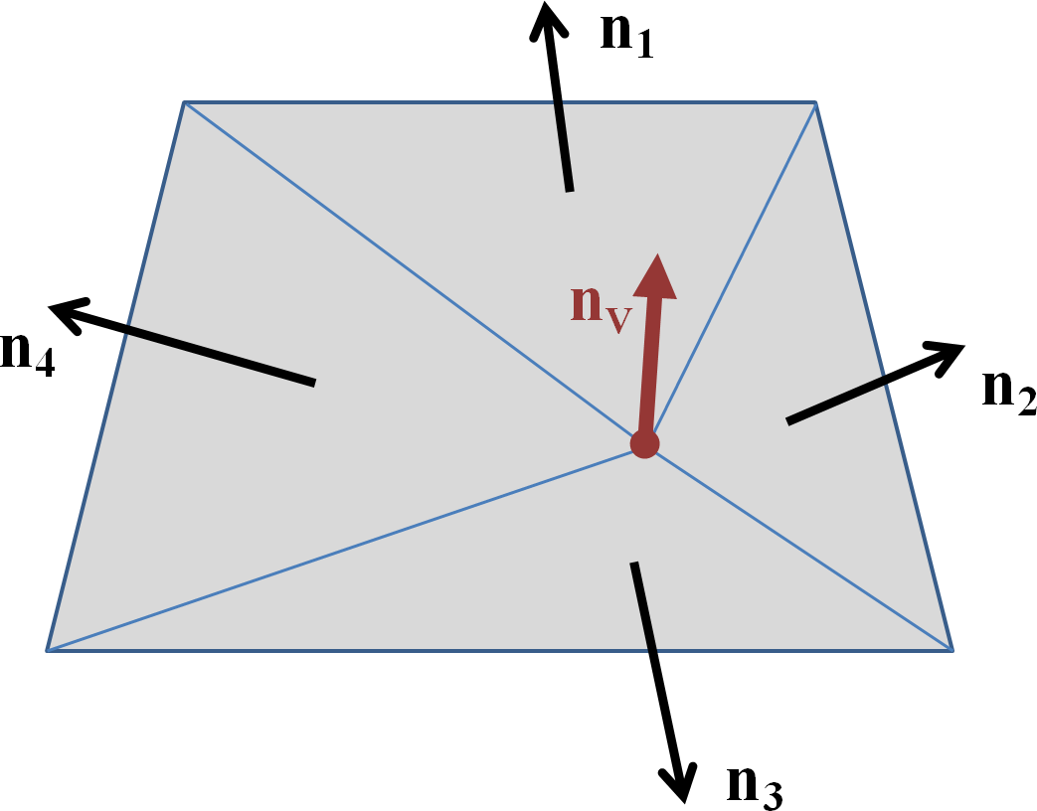
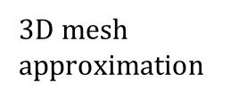
Shading Rule (5/6)
Vertex normals
normals not specified explicitly
if vertex used by only one face, normal is set to face's normal
otherwise, normal is set to average of normals of all faces sharing it
if mesh is not too coarse, vertex normal is a decent approximation to the normal of modeled surface closest to that vertex
adaptive meshing adds more triangles in areas with rapid changes in curvature
2D curve approximation
(vertex normals in green)
Vertex normals shown in color, face normals in black
$3D$ mesh approximation

Slide 16
Shading Rule (6/6)
OpenGL provides either flat or Gouraud shading
to get flat shading, use the same normals for different vertices
Unfortunately:
modeling choice influences rendering effect (contrary to PARC’s MVC paradigm)
non-shared vertex model is more storage inefficient, harder, and error-prone to change (e.g., moving one vertex would create a hole in the mesh)
Faceted
Smooth

Slide 17
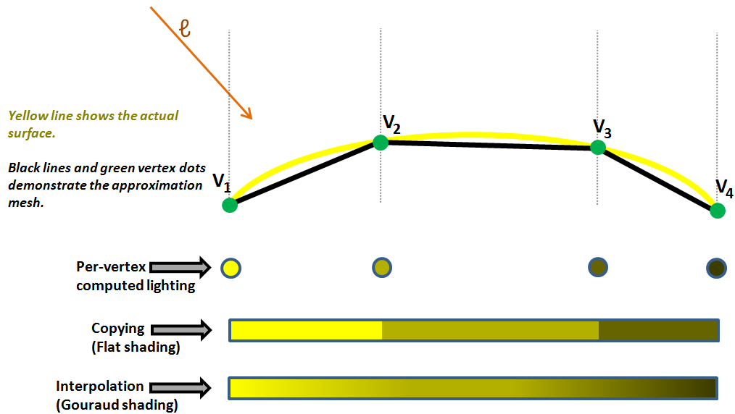
Interpolation vs Flat Shading Summary

Slide 18
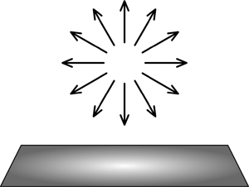
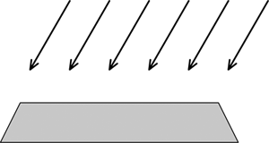
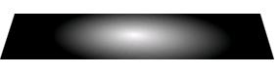
Lighting Model (1/8)
Non-geometric lights:
Ambient: crude approximation to inter-object reflection, all surfaces receive same light intensity
Directional: illuminates all objects equally from a given direction; light rays are parallel (models sun)
Geometric lights:
Point: Originates from single point, spreads outward equally in all directions
Spotlight: Originates from single point, spreads outward in coned direction
Area: Originates from single plane and spreads outward in given direction from plane
Volume: Enclosed space lighting objects within that space
OpenGL supports ambient, directional, point, spot lights
Directional
Point
Spotlight

Slide 19
Lighting Model (2/8)
float ambient[] = { 0.2, 0.2, 0.2, 1.0 };
float position[] = { 10.0, 5.0, 8.0, 1.0 };
float direction[] = { 1.0, 2.0, 3.0, 0.0 };
// Specify color(s)
glLightfv(GL_LIGHT0, // or GL_LIGHT1, GL_LIGHT2, etc
GL_AMBIENT, // or GL_DIFFUSE, or GL_SPECULAR
ambient); // or diffuse / specular color, respectively // Point light
glLightfv(GL_LIGHT0, GL_POSITION, position);
// Directional light
glLightfv(GL_LIGHT0, GL_POSITION, direction);
GL_POSITION is not a typo! OpenGL uses a linear algebra trick (homogenization) for light directions. More later in the course.

Slide 20
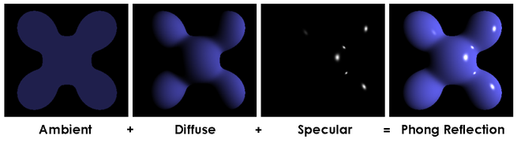
Lighting Model (3/8)
Many models exist to approximate lighting physics – the more accurate, the more computation required
OpenGL: Phong reflection model , survives today (though crude)
approximates lighting by breaking down into three components: ambient, diffuse, specular
can think of these as coincident layers, each with its own characteristics, we sum them to get the final result
non-global illumination model – model does not handle inter-object reflections
AMBIENT Effect of light that is non-directional, affecting all surfaces equally.
 | + | DIFFUSE Effect of directional light on a surface with a dull/rough finish.
 | + | SPECULAR Effect of directional light on a shiny surface when the eye-point is close to the light’s reflected rays.
= | THE COMPOSITE The three independent reflectivity types are accumulated to produce the result.
Note: The book uses a similar graphic that features the familiar teapot

Slide 21
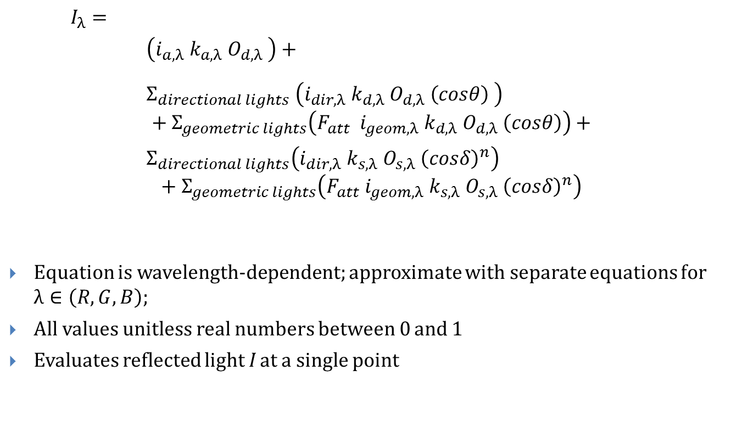
Lighting Model (4/8)
$$I_{λ}=$$
$\left(i_{a,λ} k_{a,λ} O_{d,λ} \right)+$
${ Σ}_{directional lights} \left(i_{dir,λ} k_{d,λ} O_{d,λ} \left(cosθ\right) \right)$ $$+ Σ_{geometric lights}\left(F_{att} i_{geom,λ} k_{d,λ} O_{d,λ} \left(cosθ\right)\right)+$$
${ Σ}_{directional lights}\left(i_{dir,λ} k_{s,λ} O_{s,λ} {\left(cosδ\right)}^{n}\right)$ $$+ Σ_{geometric lights}\left(F_{att} i_{geom,λ} k_{s,λ} O_{s,λ} {\left(cosδ\right)}^{n}\right)$$
Equation is wavelength-dependent; approximate with separate equations for $λ∈\left(R, G, B\right);$
All values unitless real numbers between 0 and 1
Evaluates reflected light I at a single point
Ambient Component
Diffuse Component
Specular Component

Slide 22
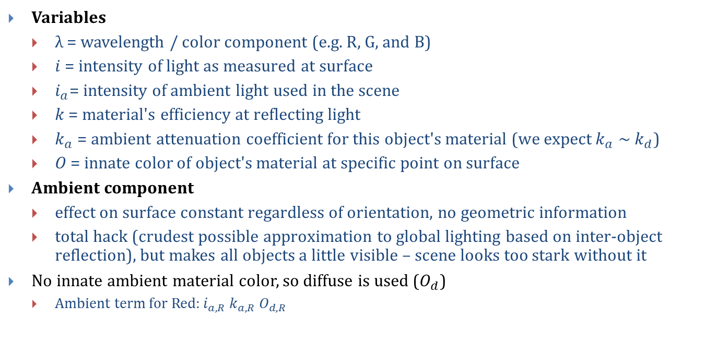
Lighting Model (5/8)
Variables
λ = wavelength / color component (e.g. R, G, and B)
$i$ = intensity of light as measured at surface
$i_{a}$= intensity of ambient light used in the scene
$k$ = material's efficiency at reflecting light
$k_{a}$ = ambient attenuation coefficient for this object's material (we expect $k_{a}$ ~ $k_{d}$)
$O$ = innate color of object's material at specific point on surface
Ambient component
effect on surface constant regardless of orientation, no geometric information
total hack (crudest possible approximation to global lighting based on inter-object reflection), but makes all objects a little visible – scene looks too stark without it
No innate ambient material color, so diffuse is used ($O_{d}$)
Ambient term for Red:$i_{a,R} k_{a,R} O_{d,R}$

Slide 23
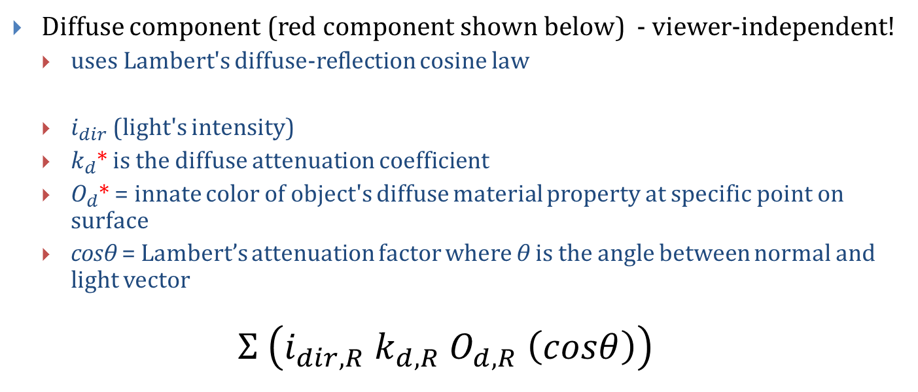
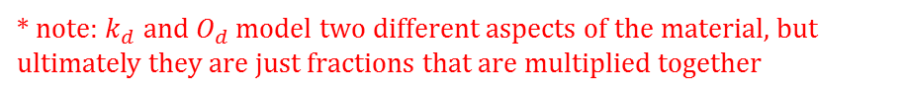
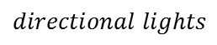
Lighting Model (6/8)
Diffuse component (red component shown below) - viewer-independent!
uses Lambert's diffuse-reflection cosine law
$i_{dir}$ (light's intensity)
$k_{d}$* is the diffuse attenuation coefficient
$O_{d}$* = innate color of object's diffuse material property at specific point on surface
cosθ = Lambert’s attenuation factor where θ is the angle between normal and light vector
$$Σ \left(i_{dir,R} k_{d,R} O_{d,R} \left(cosθ\right)\right)$$
$$directional lights$$
* note: $k_{d}$ and $O_{d}$ model two different aspects of the material, but ultimately they are just fractions that are multiplied together

Slide 24
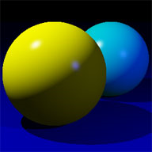
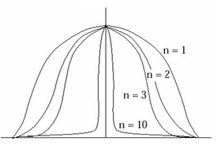
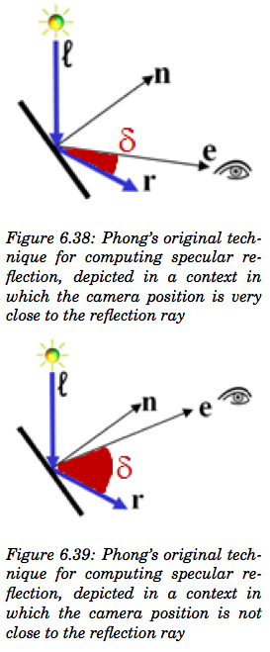
Lighting Model (7/8)
Specular Component (for red) – viewer-dependent
highlights seen on shiny objects (metal, mirrors, etc)
cosine-based attenuation factor ensures highlight only visible if reflected light and viewer are closely aligned
n = specular power, how "sharp" highlight is – the sharper, the more intense
specular highlight of most metals are the color of the metal but those on plastic, shiny apple, pearl, etc. are mostly the color of the light (see Materials chapter)
$$Σ_{directional lights}\left(i_{dir,R} k_{s,R} O_{s,R} {\left(cosδ\right)}^{n}\right)$$
e = viewpoint
r = reflected image of light source
ℓ = vector from the light source
n = surface normal
δ = angle between e and r
n = specular coefficient
Specular falloff of cos ^{n}
Note: OpenGL uses a slightly different lighting model called Blinn-Phong. See 30.5.2

Slide 25

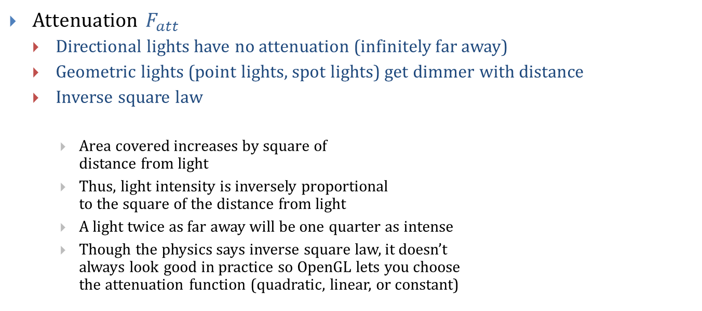
Lighting Model (8/8)
Attenuation $F_{att}$
Directional lights have no attenuation (infinitely far away)
Geometric lights (point lights, spot lights) get dimmer with distance
Inverse square law
Area covered increases by square of distance from light
Thus, light intensity is inversely proportional to the square of the distance from light
A light twice as far away will be one quarter as intense
Though the physics says inverse square law, it doesn’t always look good in practice so OpenGL lets you choose the attenuation function (quadratic, linear, or constant)
d
d
d

Slide 26
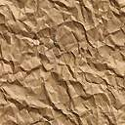
Texture Mapping
Goal: adding more detail to geometry of scene without adding complexity
Solution: texture mapping
used extensively in video games, e.g., for backgrounds, billboards
also used for many other techniques such as level-of-detail management
cover the mesh's surface in (stretchable) "contact paper" with pattern or image on it
in general, difficult to specify mapping from contact paper to every point on an arbitrary 3D surface
mapping to planar polygons is easy: specify mapping for each vertex and interpolate to find mapping of interior points
Specifying "texture point" mapped to particular vertex
requires coordinate system for referring to positions within texture pixmap
convention:
points on pixmap described in abstract floating-point "texture-coordinate system"
axes labeled u and v, range 0 to 1.
origin located at the upper-left corner of the pixmap
(0,0)
U axis (1,0)
V axis
(0,1)

Slide 27
Texture Mapping Example
QImage img; Gluint textureID;
// Load image from file on disk (using Qt) img.load(“sand.gif”); img = img.convertToGLFormat(img);
// Create texture on graphics device glGenTextures(1, &textureID); // 1: generate one texture only // Load image data into texture glBindTexture(GL_TEXTURE_2D, textureID); glTexImage2D(GL_TEXTURE_2D, 0, GL_RGBA, img.width(), img.height(), 0, GL_RGBA, GL_UNSIGNED_BYTE, img.bits());
Full glTexImage2D Documentation:
http://www.opengl.org/sdk/docs/man/xhtml/glTexImage2D.xml

Slide 28
Texture Mapping Example
// Draw the desert floor using the texture glBegin(GL_QUADS); glTexCoord2f(0, 0); glVertex3f(-9999, 0, 9999); glTexCoord2f(1, 0); glVertex3f(9999, 0, 9999); glTexCoord2f(1, 1); glVertex3f(9999, 0, -9999); glTexCoord2f(0, 1); glVertex3f(-9999, 0, -9999); glEnd();

Slide 29
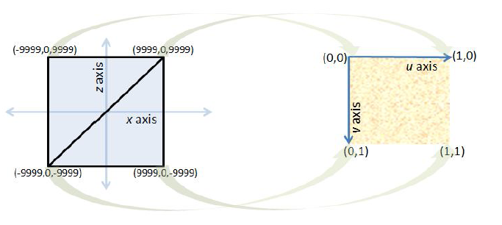
Texture Mapping UV Coordinates
We are mapping from the two coplanar triangles in the 3D model to a texture map
Texture map uses UV texture coordinates
Texture mapping arbitrary solids is much harder – we’ll study this later

Slide 30
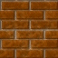
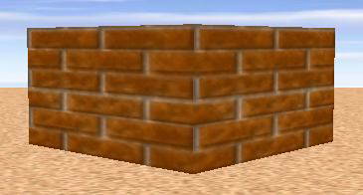
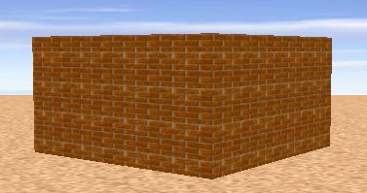
Texture Mapping (Tiling)
Create a brick wall by applying brick texture to plane
Produces realistic-looking image, but very few bricks in wall
Tiling increases number of apparent bricks

Slide 31
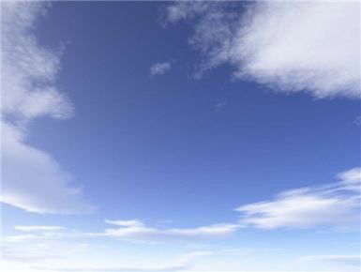
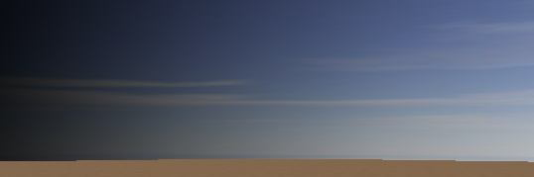
Texture Mapping (Stretching)
Create a sky backdrop by applying a sky image to a plane
Would look unnatural if tiled
Stretch to cover whole plane
OpenGL lets you specify tiling and stretch factors

Slide 32
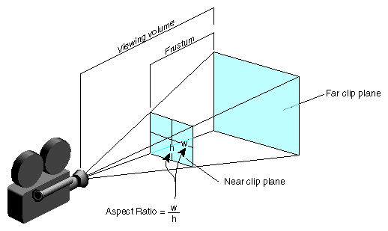
Camera (1/3)
Camera Properties:
Perspective or Orthographic
Position: placement of camera
Look Direction: direction camera is aimed (vector determining lens axis)
Up Direction: rotates camera about look vector, specifying which way is “up” – must not be collinear to the look vector
Far-Plane Distance: objects behind do not appear
Near-Plane Distance: objects in front do not appear
Field Of View: (Height Angle)
Aspect Ratio (Relative width and height)

Slide 33
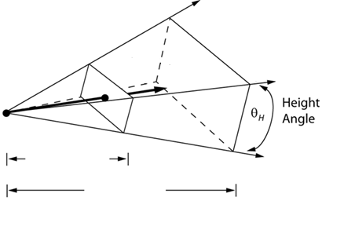
Camera (2/3)
Perspective Projection
Look Direction
Projection of Up Direction
Up Direction
Position
Near-Plane Distance
Far-Plane Distance

Slide 34
Camera (3/3)
Orthographic Projection
Width
Far distance
Height
Look vector
Near distance
Projection of
up vector
Up vector
Position

Slide 35
OpenGL Camera
Support for perspective and orthographic cameras.
Example for perspective camera: // Projection matrix captures 3D -> 2D conversion glMatrixMode(GL_PROJECTION); gluPerspective(45, // Field of view window->width() / window->height(), // Aspect ratio 0.02, 1000); // Near, far plane distances // Modelview matrix captures positioning and orientation glMatrixMode(GL_MODELVIEW); gluLookAt(54, 51, 247, // Camera position (X, Y, Z) 2, 0, 9, // Point camera is looking at (X, Y, Z) 0, 1, 0); // Up direction (X, Y, Z)

Slide 36
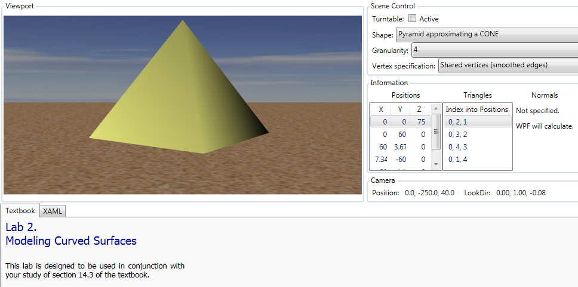
WPF3D Lablets (1/2)
Hands on exploration of concepts discussed in this lecture
Modeling smooth surfaces
www.sklardevelopment.com/graftext/wpf/3d

Slide 37
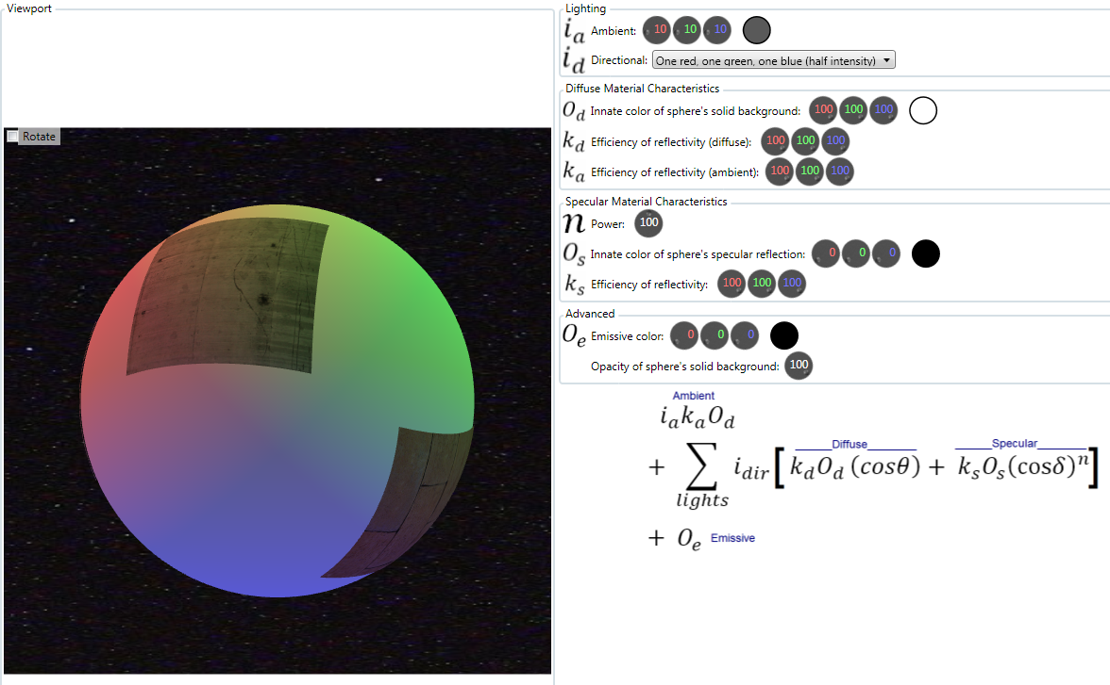
WPF3D Lablets (2/2)
Lighting and shading model
www.sklardevelopment.com/graftext/wpf/3d

Slide 38
Book Sections
Intro
Chapter 6

